Slide 1

Let’s Unite
Abdulrahman Alshaghdali
Supervisor: Jonathan Mccarthy
Notes:
Greetings with names and introduce Myself
-------------------------------------------------FEEDBACK:

Slide 2
Overview
The aim of this project is to:
Ice-Breaking.
Find who’s free, I’m bored.
Interested in knowing news happening around you.
You are with friends, let the others join (Grouping).
Notes:
-
-------------------------------------------------FEEDBACK:

Slide 3
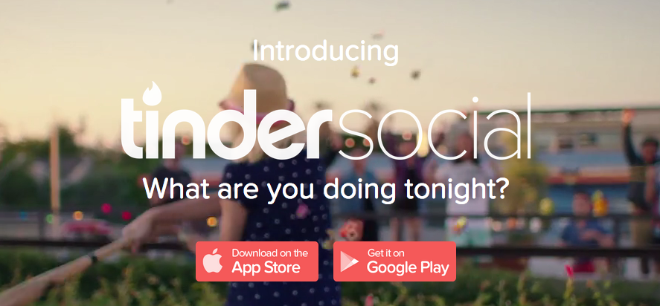
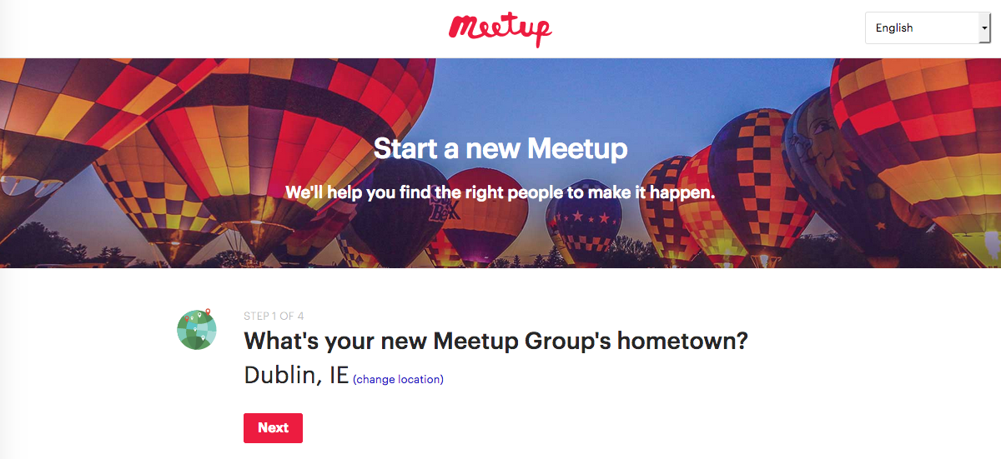
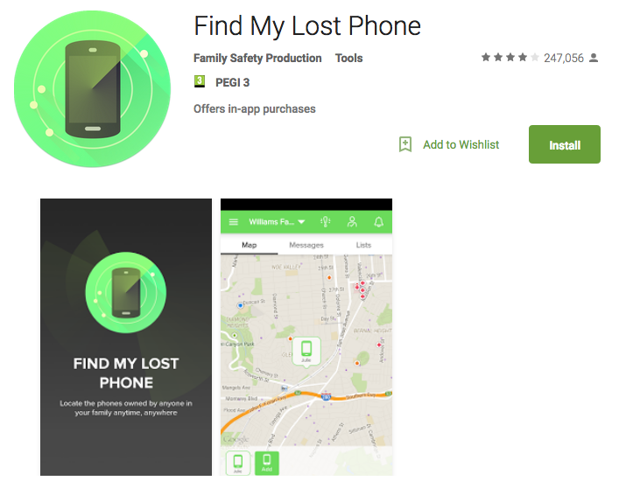
Research - Background
What is the problem ?
Existing solutions:
Notes:
1- Need to explain the problem that we are trying to solve. Taking new students as example.
2- Explain the existing technologies that have almost the same idea.
-------------------------------------------------FEEDBACK:

Slide 4
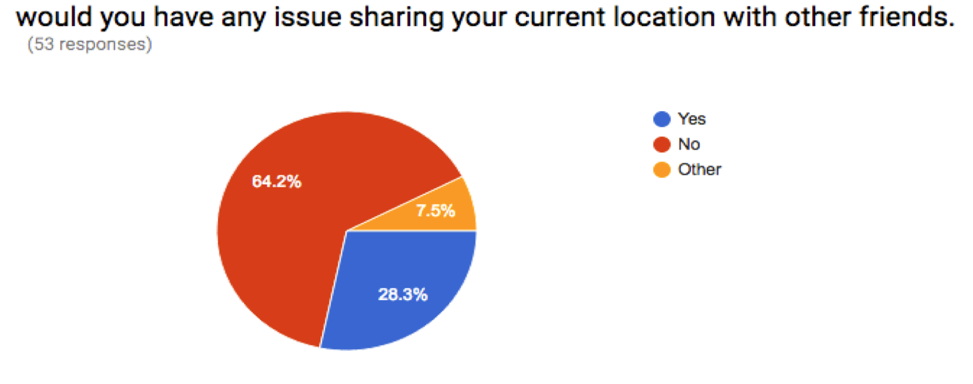
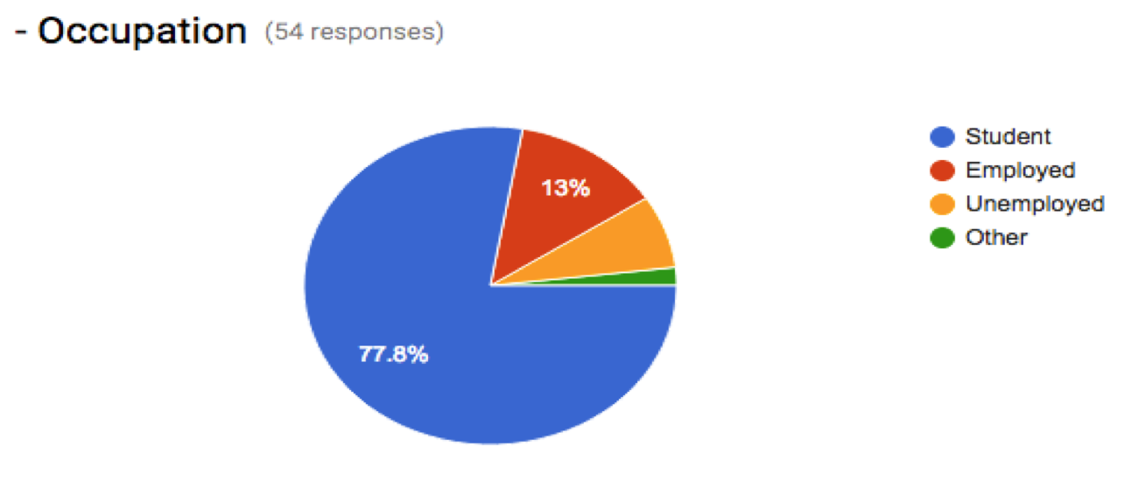
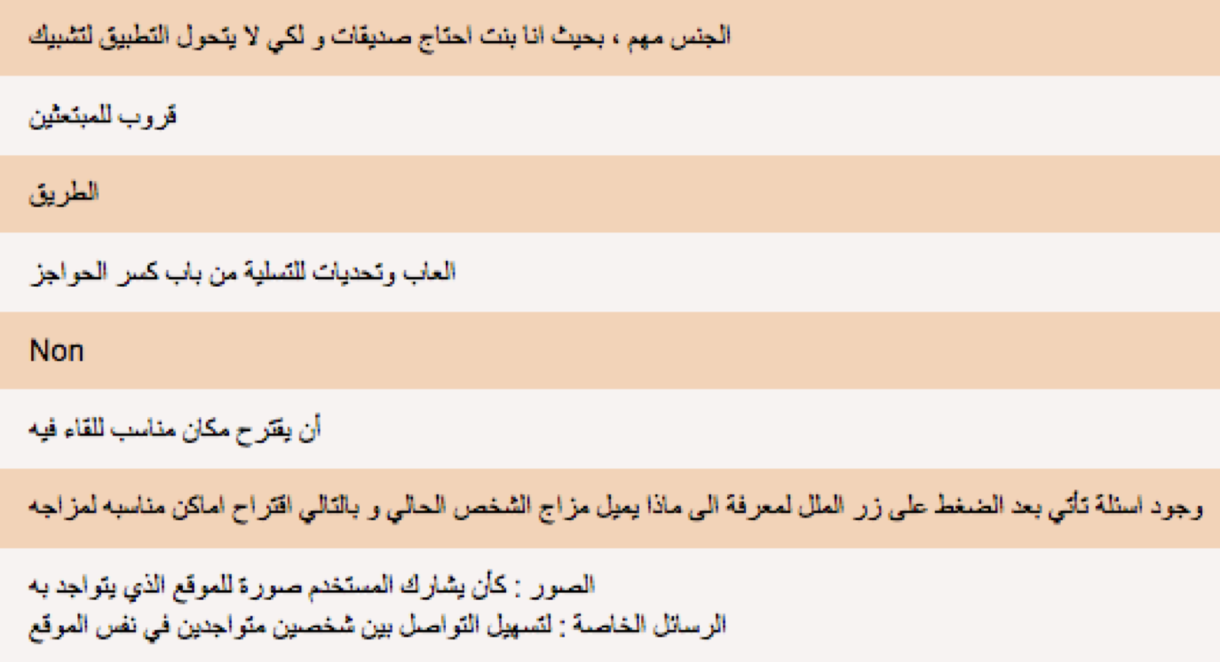
Relevant Research
Questionnaire & Interview:
87 responses received.
Questionnaire covered two languages.
Valuable findings and results gathered.
More understanding of users need.
Improve functionalities.
Notes:
Questionnaire was sent to more than 300 people mostly students.
Questionnaire: total of 87 responds.
The rest of the design followed the users need following their feedback.
-------------------------------------------------FEEDBACK:

Slide 5
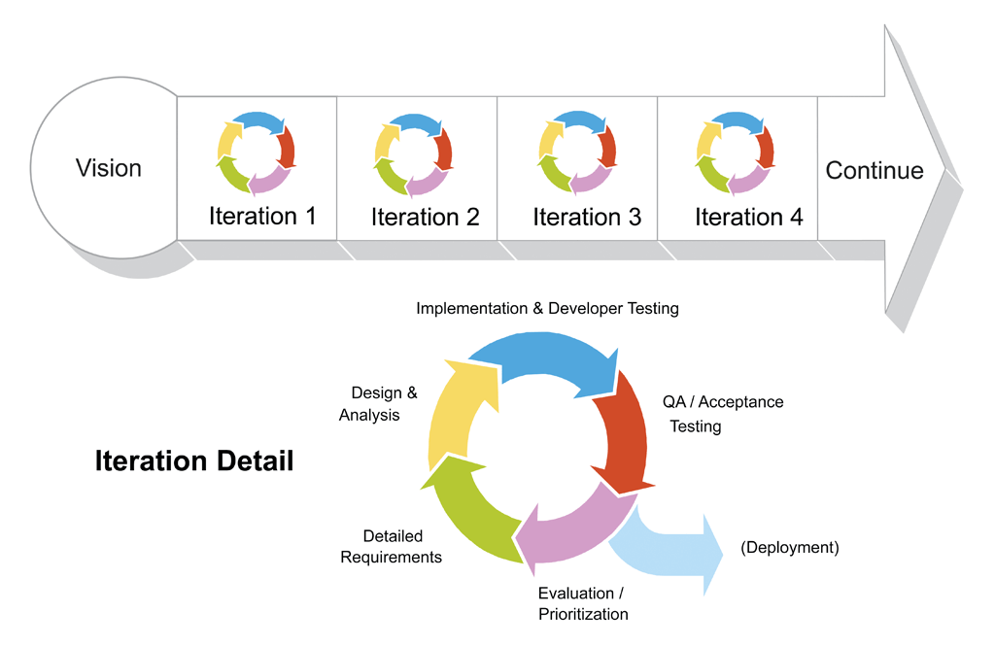
Methodology
Agile methodology (Scrum Process):
Notes:
Why did I chose it ?
How it works.
It will help a lot in case of redesign and testing.
Most sufficient in such project.
-------------------------------------------------FEEDBACK:

Slide 6






Technologies
Mobile Application:
Server:
Database:
Notes:
Three main technologies that the system will be depending on:
Using android studio to implement the mobile application. Targeting Android. JAVA → IOS - Window
Middle tire Python to implement the server. Python is scripting language – → Django has its own way
Database will be implemented using MySQL.→ PostgreSQL
-------------------------------------------------FEEDBACK:

Slide 7
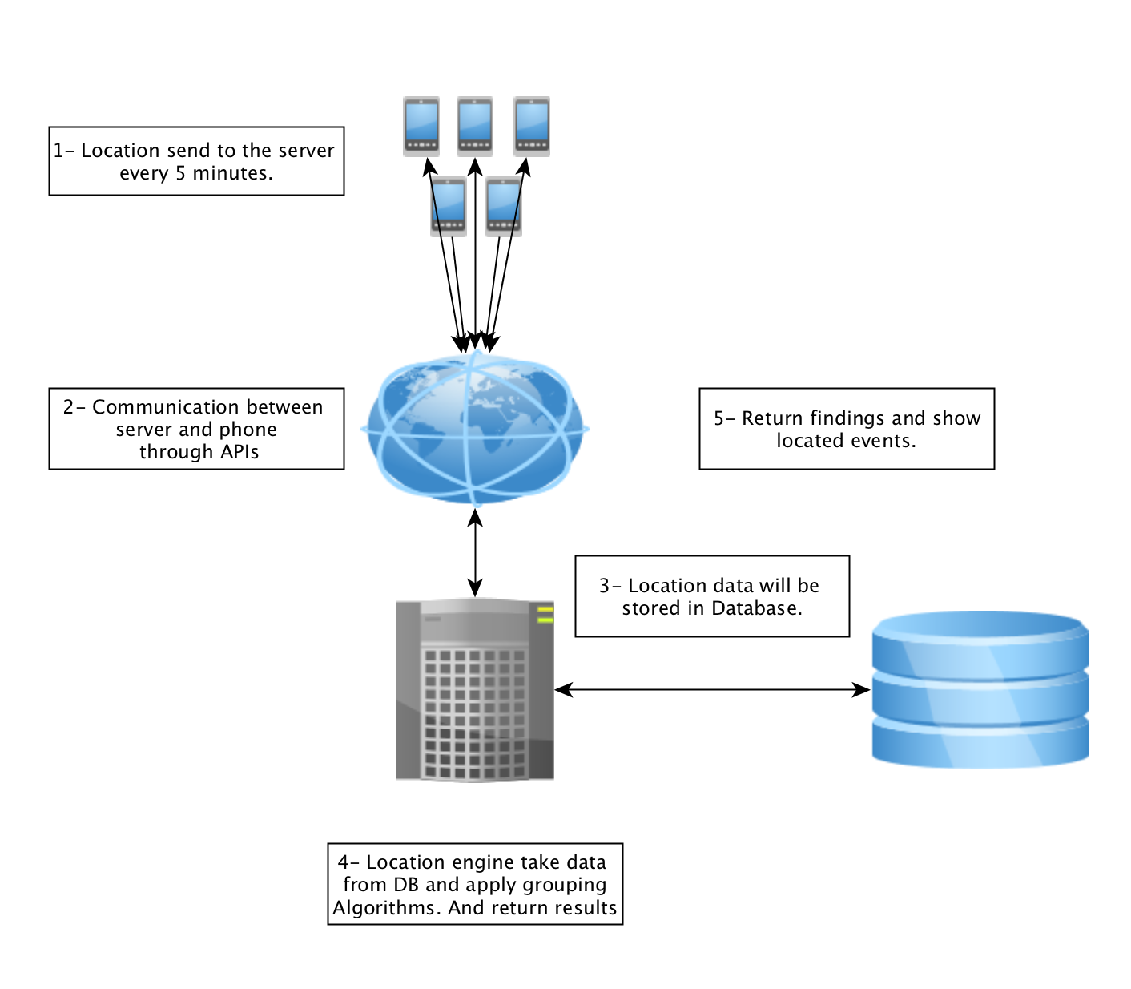
High Level system Design
Notes:
- Corntab used to schedule the server running time.
-------------------------------------------------FEEDBACK:

Slide 8
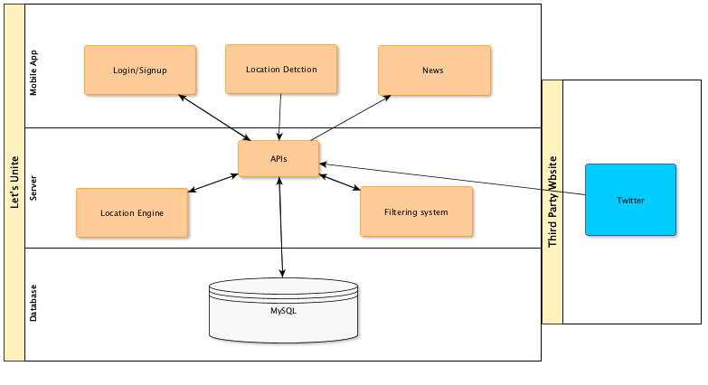
Technical Architecture
Notes:
-------------------------------------------------FEEDBACK:

Slide 9
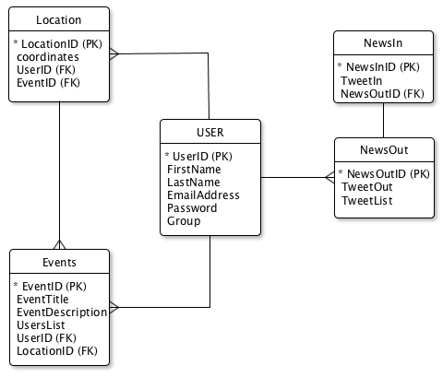
ERD Diagram

Slide 10

Algorithm Complexity
Implementing algorithms to group users in order to create an event following below steps as the general design of the algorithm:
Sort data to improve matching performance:
Merge sorting algorithm: Divide → Conquer → Combine
Matching quires or Search algorithm:
St Stephens Green: 53.3384723, -6.2606970
Trinity College: 53.3436196, -6.2617653
Create new list for all matching location.
Applying distance calculation algorithm:
Calculate distance between matching location list finding users with less than 15 M between them.
Manhatan distance algorithm, Haversine algorithm.
Notes:
Alternative algorithms:
Haversine algorithm
Google Distance Matrix API
Crontabs can be used to schedule the algorithm which works like a calendar.
Google places can be used to specify the place.
-------------------------------------------------FEEDBACK:

Slide 11
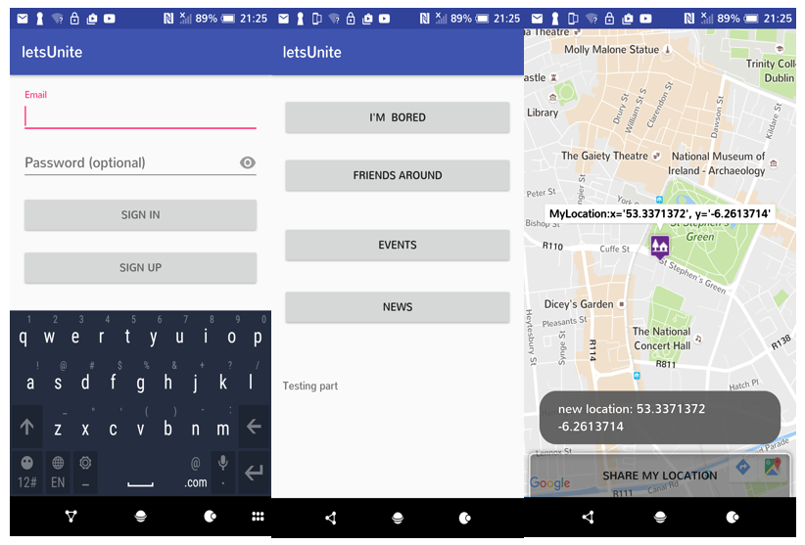
Prototyping (Horizontal)
Login → Main menu → I’m bored, which will show a map to specify location.
Notes:
Showing horizontal prototyping which allowing user to specify their location.
-------------------------------------------------FEEDBACK:

Slide 12
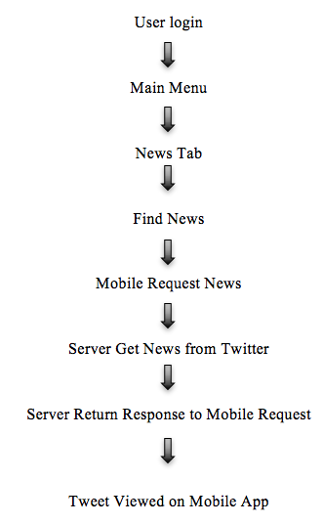
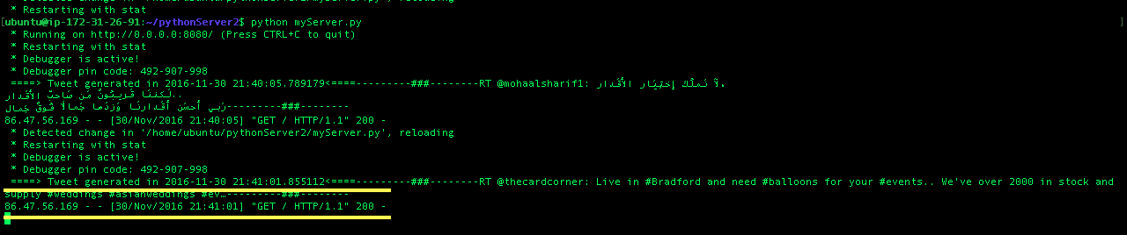
Prototyping (Vertical)
Notes:
Vertical prototyping which allow user to request and view news from twitter.
-------------------------------------------------FEEDBACK:

Slide 13


Testing
Unit testing:
Test GUI.
Test Rest API.
Test functionality of the App.
Applying scrum while implementing.
User testing:
Ask few users to use the App as group.
Make sure the flow of the application is clear to navigate.
Apply a full experiment to test application.
Notes:
-------------------------------------------------FEEDBACK:

Slide 14

Issues & Risks
Testing can be an issue as the project is depending on locations and movements of the user.
Minor changes on the grouping algorithm, it is expected to improve accuracy as using scrum methodology.
Other expected issues such as lost connection and running out of credit while using a cloud services.
Notes:
-------------------------------------------------FEEDBACK:

Slide 15

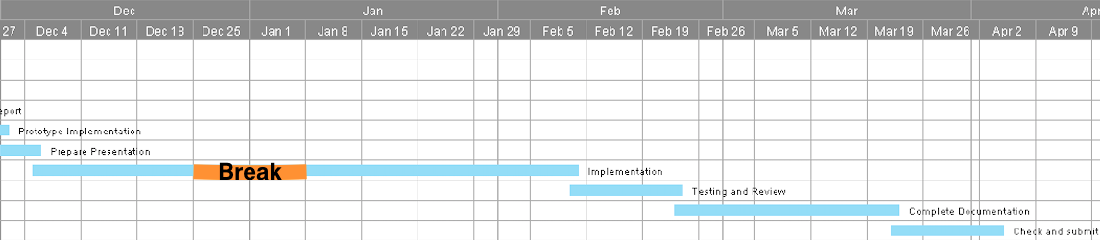
Future Work
Notes:
Implementation takes around two months as im using Agile scrum methodology.. Which will take full process for every function.
-------------------------------------------------FEEDBACK:

Slide 16

Questions
Notes:
-------------------------------------------------FEEDBACK:

Slide 17

Thank You ☺
Notes:
-------------------------------------------------FEEDBACK:

